Slide 1
Brainfood
Developing interventions to prevent dementia: role of diet & lifestyle
Anna Betz, Lead Practitioner in Camden Memory Service, Endobiogenic Herbalist & Coach
In collaboration with Rainbowhood Foundation & Brighton Health and Wellbeing Centre
www.unleashourhealth.com mob: 07731584358

Slide 3
1 in 5 people over 70 have MCI (mild cognitive impairment)
46% of people with MCI develop dementia in 3 years compared to 3% without MCI.

Slide 4
What predicts dementia in MCI?
Diabetes
Metabolic syndrome
Excessive alcohol
Neuropsychiatric symptoms
…and Mediterranean diet protects

Slide 7
Session 2: Good and bad carbohydrates
The brain uses more fuel than any other part of the body, and works better with a steady fuel supply. Avoiding glucose and insulin spikes is good for your brain. You can do this.
by eating complex carbohydrates
and combining them with some
protein
by eating less carbohydrates
overall

Slide 8
Session 3: Good and bad fats
Looking at fats:
saturated fats
trans fats
unsaturated fats
Omega-3

Slide 9
Session 4

Slide 11
Stress
Stress elevates cortisol (the major stress hormone) and switches off repair mechanisms
Chronic (persistent) stress can affect thyroid health, heart health, immune health and can cause brain shrinkage
Stress can deplete the adrenal glands (and can ultimately lead to ‘burn-out’)

Slide 12
Mindfulness
Feeling stressed and worried can make memory problems worse.
Relaxation can help
“three minute breathing space”
There are three steps. Let’s try them together now.
Become aware: step out of automatic pilot to ask “Where am I?” “What’s going on here? The aim is to recognise and acknowledge your experience in the moment.
Gather and focus you attention: gather the scattered mind to focus on your breathing
Expand your attention to include the sense of breath and body as a whole.

Slide 13
Nerve and blood vessel damage

Slide 15
Main message
People with MCI want information about preventing dementia. Best available information:
Maintain good physical health – use good oils/fats, reduce carbs, cut out sugar (especially treat diabetes & heart disease/metabolic syndrome)
Maintain good mental health (avoid apathy, depression)
Eat well and stay mentally and physically active (ie: 30 mins brisk walking, 5-6 times a week)
Ensure you get enough good quality sleep (8 hrs)
Don’t eat late in the evening. Fast for 12 hours or more overnight

Slide 16
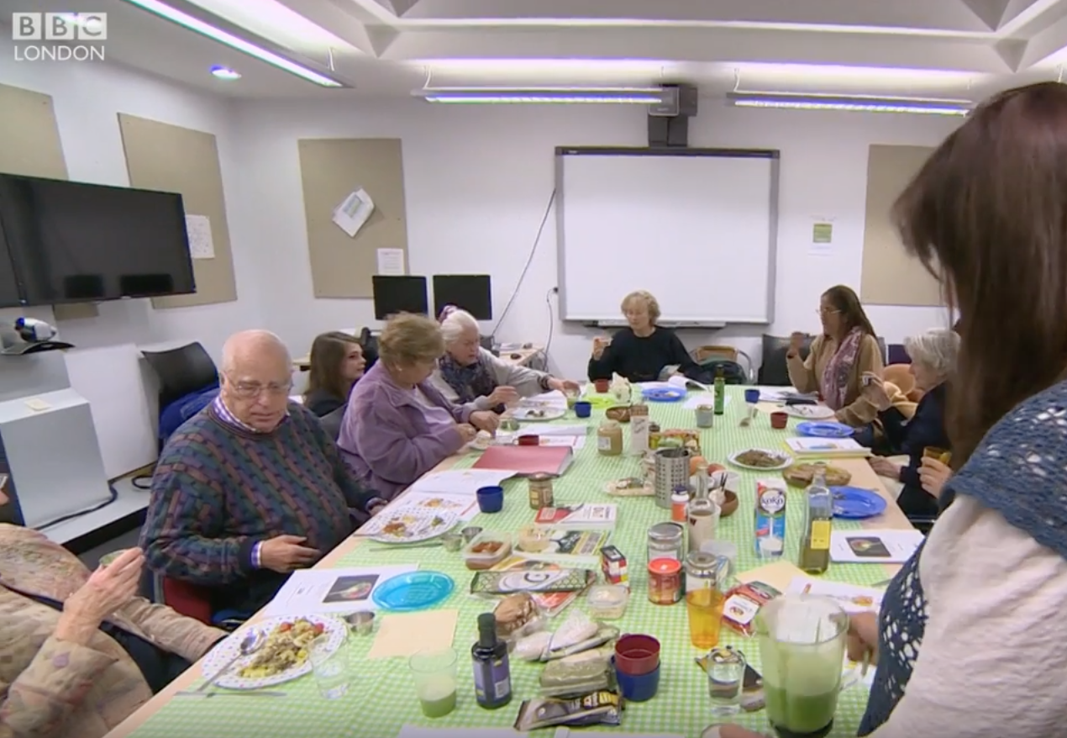
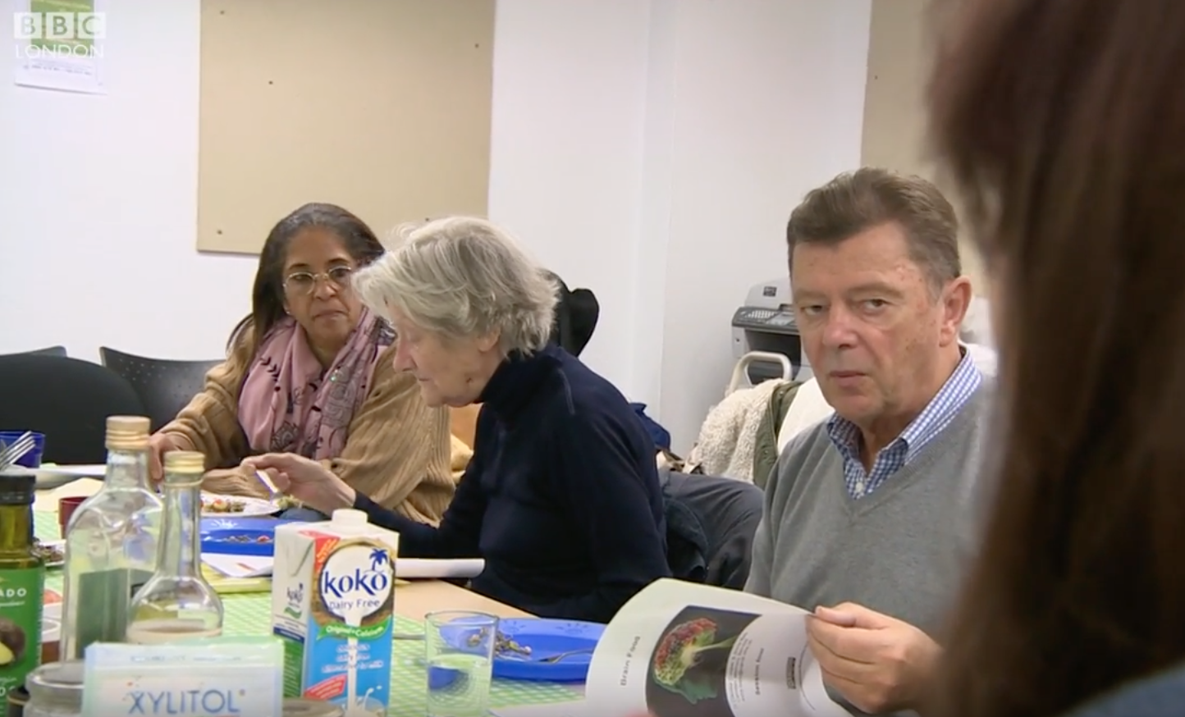
BBC London, DEC. 2016: https://youtu.be/-NM_xmxLq94
Jill and Caroline - https://vimeo.com/200803914

Slide 17
How participants rated sessions overall

Slide 18
Have you changed what you eat?

Slide 19
It gave me food ideas to try out

Slide 20
The Pilot study showed that a low intensity intervention to promote a healthy lifestyle in people with MCI & mild dementia was feasible to implement in a real world NHS setting.
Thanks to the success of the pilot study, the APPLE Tree programme was born.

