Slide 1
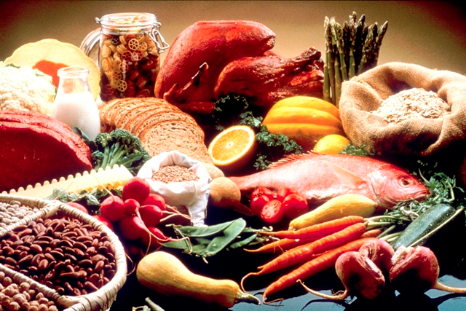
Stabilising Blood Sugar the mindful way to create the conditions for becoming whole

Slide 2
A journal based course to support learning and behaviour change
Attending to the person who suffers from the disease and not just the disease.
Creative delivery of patient centred care:
1. Mindfulness based practices to open the doors of perception
“Between stimulus and response there is a space. In that space is our power to choose our response. In our response lies our growth and our freedom.” Victor Frankl

Slide 3
Normalising insulin levels and reducing insulin resistance through a whole person approach
Stress reduction & Relaxation
Sleep quality
Nutrition
Exercise

Slide 4
A colourful, tasty, varied & healthy diet
Contents
Session 1: Body-Mind, Sleep, Starting well
Session 2: Good & bad carbohydrates
Session 3: Good & bad fats
Session 4: The Mediterranean diet, Vitamins,
Minerals, Herbs,
Session 5 & 6: Exercise, Self-care journey planning

Slide 5
Circadian rhythm:
sleep/wake
cycle
Day
Serotonin
Evening Cortisol levels drop
Night
Serotonin converted to melatonin
Early morning
Cortisol levels begin to rise

Slide 10
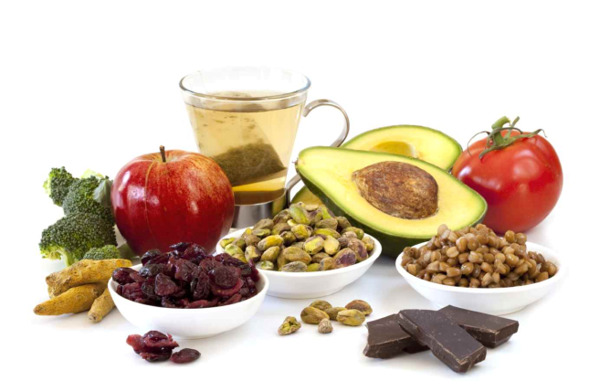
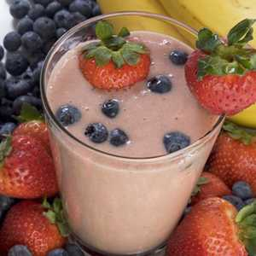
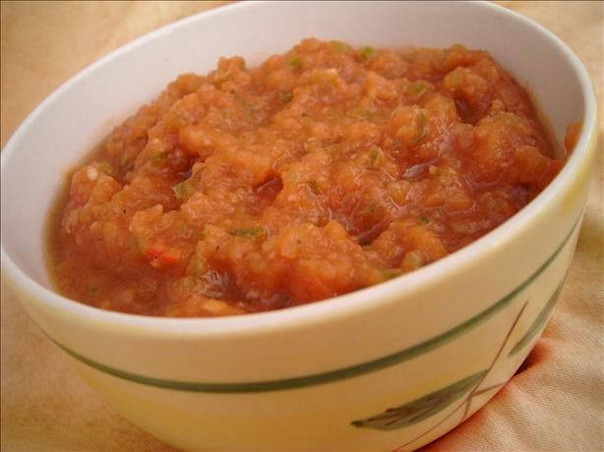
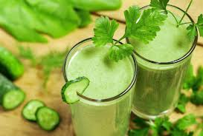
Some foods to prepare and try

Slide 11
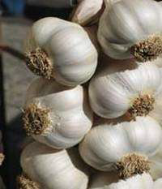
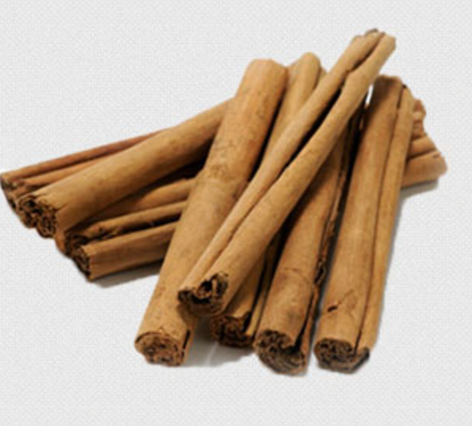
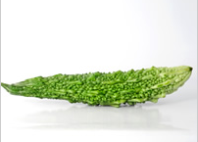
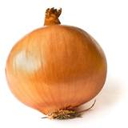
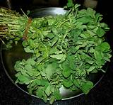
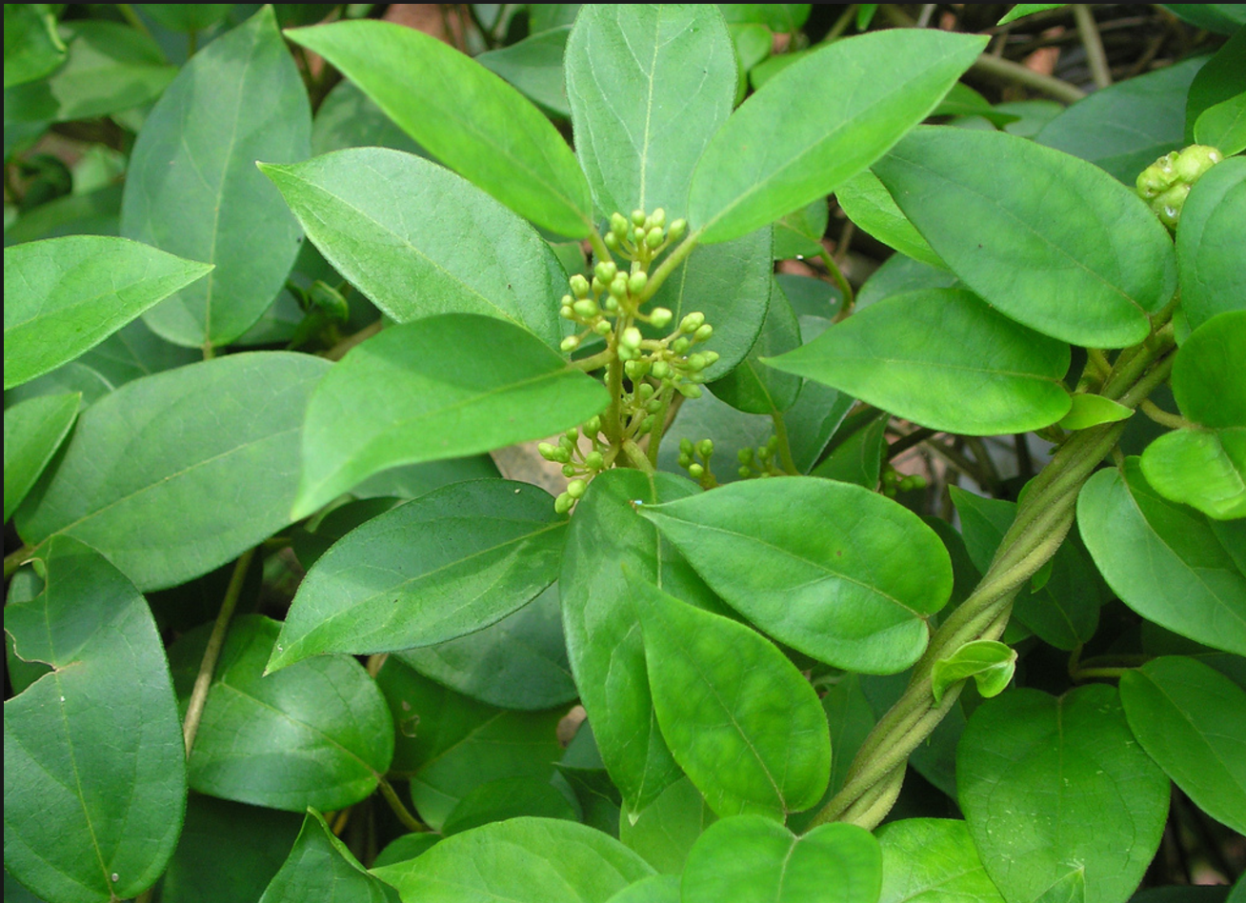
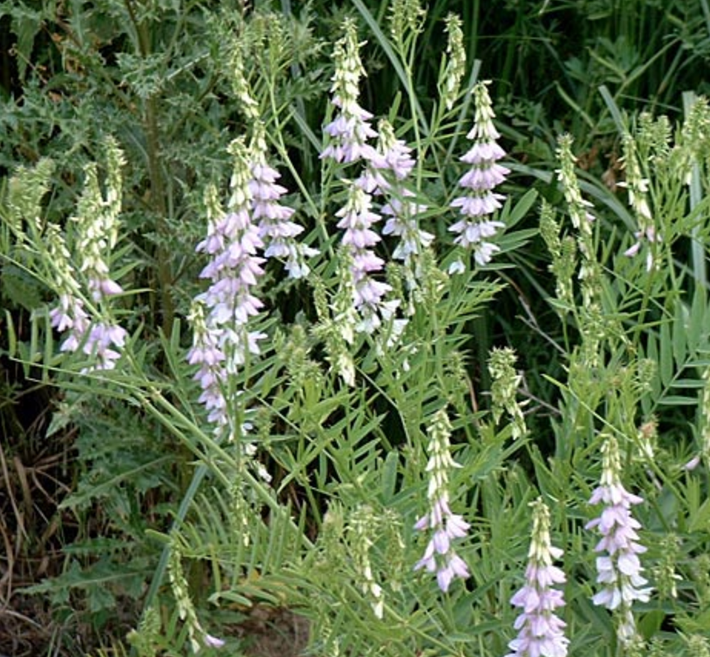
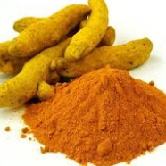
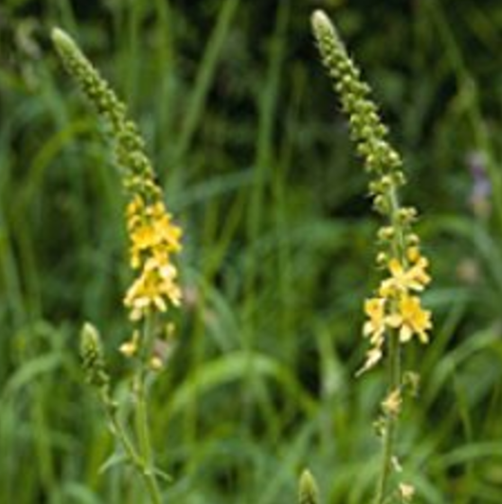
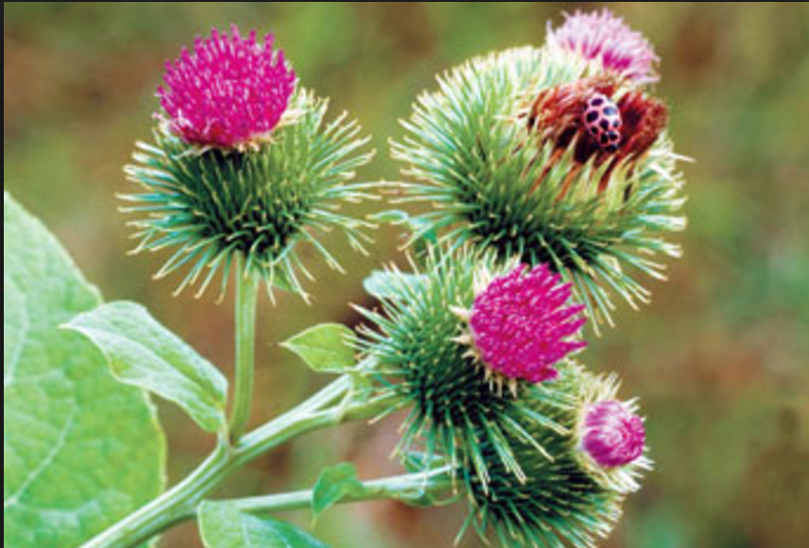
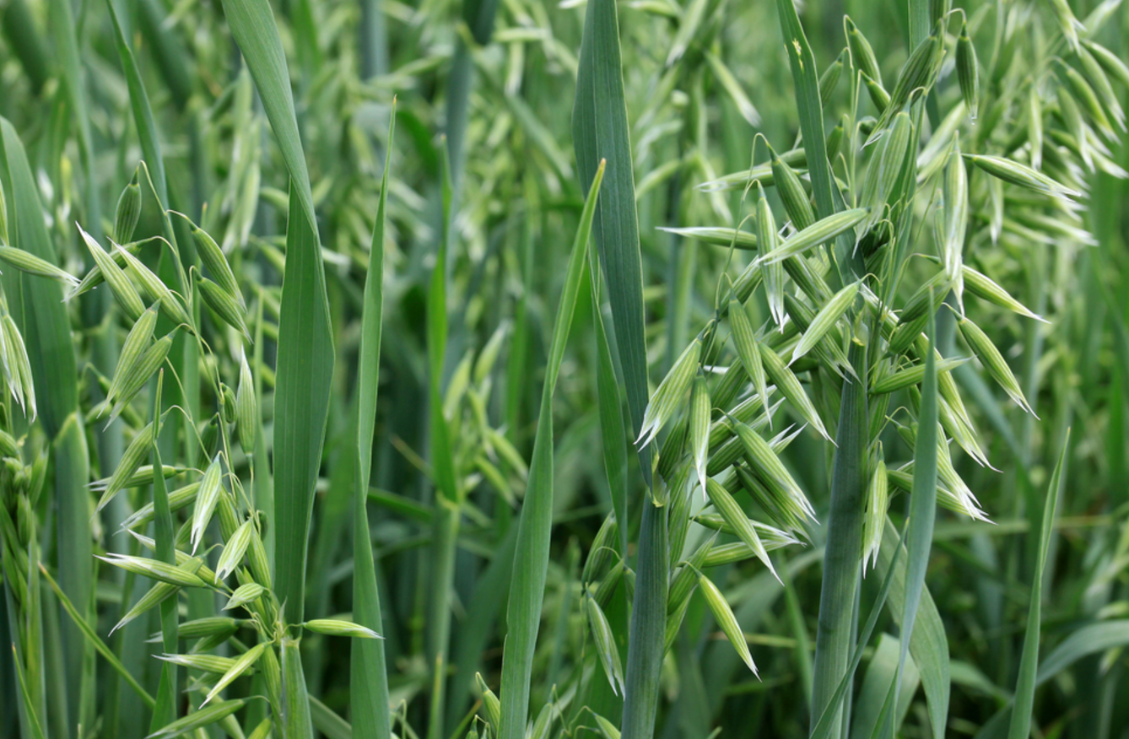
Herbs and Spices

Slide 12
Microbiome
Naturally Fermented foods: (non-pasteurised)
Populate the gut with beneficial bacteria and support immune function.
Organic raw Miso
Sauerkraut
Kambucha drink
Kefir
Organic Probiotic yoghurt

Slide 13
Liver & Kidney Flush
in the morning on empty stomach
1 teasp Cider Vinegar,
(1 teasp fresh Lime juice)
¼ teasp Turmeric,
pinch of chilli pepper
Mix with large glass of warm water (300-400ml) and drink first thing in the morning 20 mins before breakfast.

Slide 14
How physical activity improves my blood sugar
Types of exercise
How much exercise?
7 Steps to help you stay motivated

Slide 18
How participants rated sessions overall

Slide 19
It gave me food ideas to try out

Slide 20
Have you changed what you eat

Slide 21
What people said about the sessions
More people need to have this learning
I have learnt lots about alternative food ingredients
I loved the snacks
I learned what oils should not be heated and why.
I will avoid bad fats
My understanding and attitude has changed regarding how I eat, what I eat, doing regular exercise, my sleep patterns
I enjoy the sessions and practising the recipes at home
I now understand what good & bad carbs and good & bad oils are
My favourite learning is learning how many different foods there are which I can use for breakfast, lunch and dinner
I learnt about relaxation

Slide 22
What people said they will definitely change
More exercise
Making smoothies
Limit dairy and refined carbs
Shop differently
Eat as much organic vegetables and fruits as possible
Change what’s in my kitchen cupboards
Follow recipes in the manuals
Avoid bad oils and fats
Increase variety of foods and mix foods in new ways
Make my own healthy snacks
Sleep more
I also want to use herbs to lower my blood sugar

Slide 23
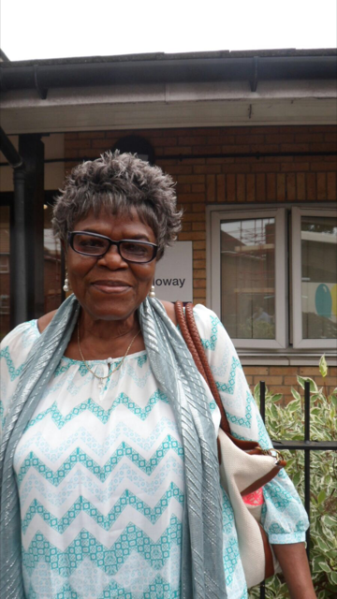
Anna this is S.P.B. who attended your Diabetes Workshop. As a result of this
my last blood test was "my diabetes is now controlled & I'm off medication.

