Slide 1
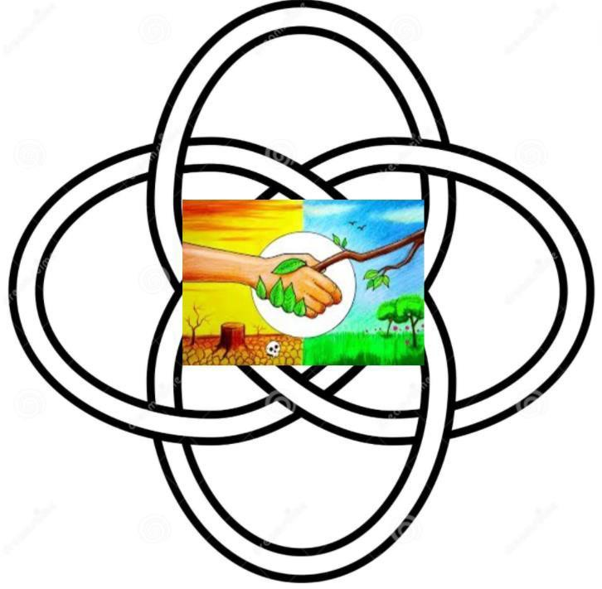
The Power and Patterns of Connectivity
People - Plant – Interconnectedness
Connecting to self, others & the natural world
Anna Betz MCCP, Endobiogenic Herbalist
www.unleashourhealth.com
Contributor to the Living Systems Periodical

Slide 2
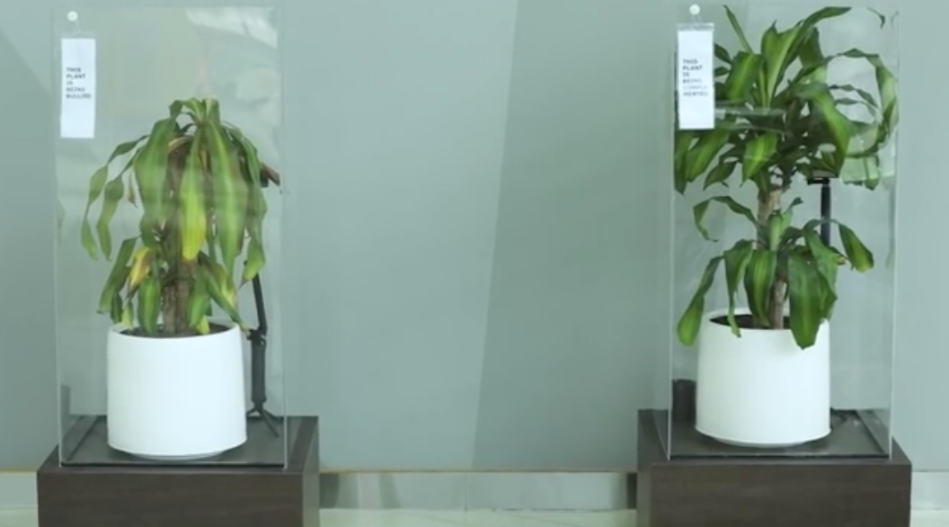
Trauma
A normal response to an abnormal situation
http://bit.ly/3EjDZpQ

Slide 3
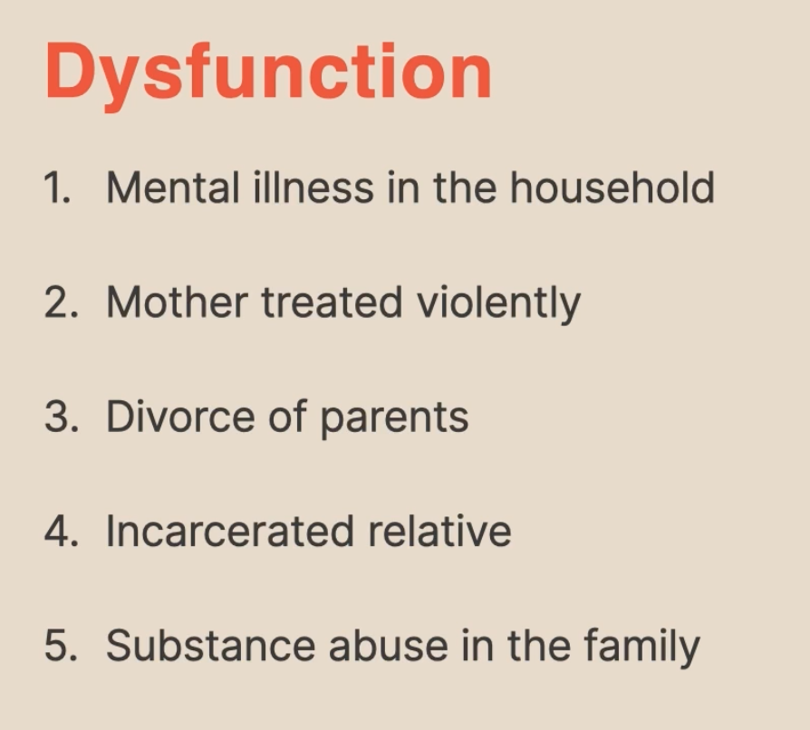
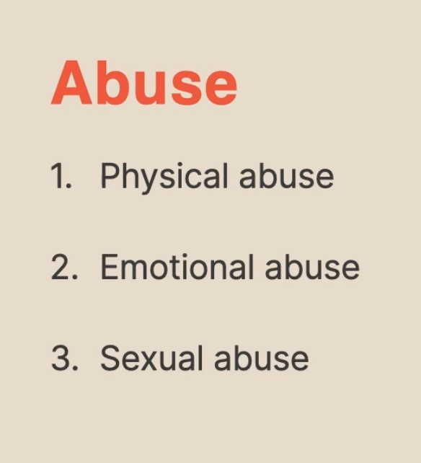
3 categories of A.C.E s
Abuse
Neglect
Household dysfunction
A.C.E. – Adverse childhood experiences
https://www.decodeyourtrauma.com/live1672834784257

Slide 4
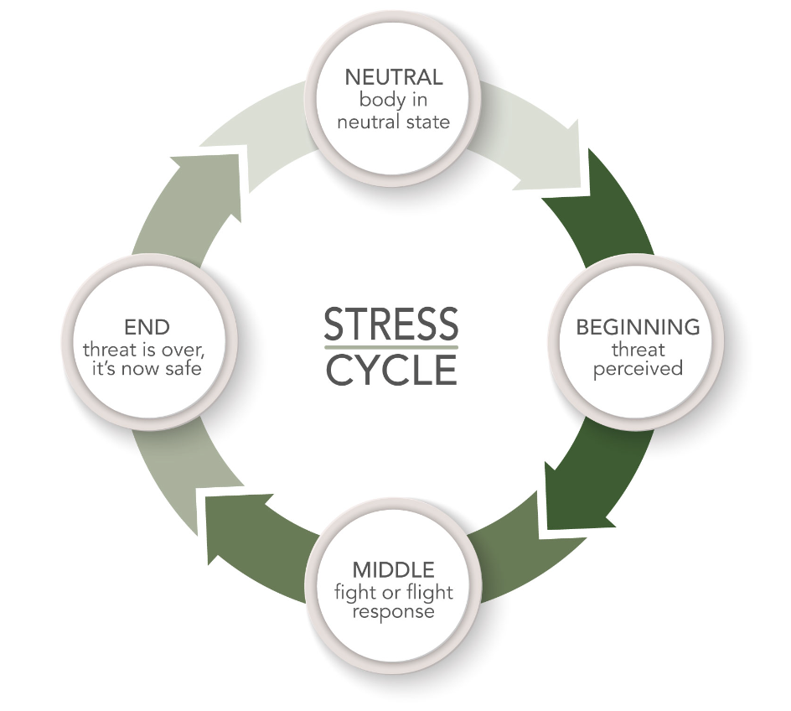
STRESS-RESPONSE CYCLE
Beginning: The body perceives a threat and the fight or flight response kicks in. The body becomes hyper alert, with faster breathing, sweating, muscle tension, the release of various adrenal and/or neuro hormones, increased heart rate and dramatically slowed digestive functions.
Middle: The body’s physical response by fight, flight, freeze, flop or fawn.
End: The body receives the signal that it has escaped the threat and is now safe.
When the brain/body doesn’t recognise that the event is over and remains stuck in it’s survival mode of fight, flight, flop, freeze or fawn, this may lead to longer term consequences affecting mental, emotional and physical health. i.e PTSD
flop, freeze,
fawn
https://stfrancisherbfarm.com/blog/stress-management-resolving-the-cycle-of-stress/
Notes:
When it comes to the body's stress responses, hormones play a significant role. The primary players in the "fight or flight" response are adrenaline (epinephrine) and norepinephrine. These hormones are released from the adrenal glands in response to a perceived threat, preparing the body for quick action.
On the flip side, cortisol, another key stress hormone, is released in response to stress and helps the body maintain steady energy levels during a stressful event. It also plays a role in the "freeze" response by inhibiting non-essential functions.
The "flop" response, which involves a sense of overwhelm or helplessness, can be associated with a decrease in dopamine levels. Dopamine is a neurotransmitter that plays a role in motivation and pleasure.
The "fawn" response, characterized by seeking social connection and approval, may involve the release of oxytocin, often referred to as the "bonding hormone." Oxytocin is associated with social bonding and positive interactions.
These hormones work in concert to help the body adapt to and cope with stress in various ways.
The intricate dance of hormones reflects the body's sophisticated response to different stressors and its ability to navigate a range of challenging situations.
Dopamine is primarily produced in the brain, specifically by neurons in various areas, including the substantia nigra and the ventral tegmental area.
Oxytocin, on the other hand, is produced by the hypothalamus and released by the pituitary gland. The hypothalamus signals the pituitary gland to release oxytocin into the bloodstream, where it can then exert its effects throughout the body, including the brain.
Dopamine, Vasopressin and Oxytocin = neuro hormones released by hypothalamus and pituitary

Slide 5
3 fundamental human needs
Boundaries (outer & inner)
‘Developing agency and influence over one’s own life feels really important and transformative. To say ‘No’ to people rather than pleasing everyone and to do that with less fear feels like a real shift. ‘
‘Not to allow myself to return to the old unhealthy habit of staying in bed until midday and feeling depressed. Having experienced the healing effect of my new choice of just getting up anyway and going for a short morning walk, this is now becoming my new routine.’
Safety (Physical & emotional safety)
‘It felt safe to be myself and explore what I really feel in the group. I didn’t feel judged. Everyone listened and allowed me to have space without making me feel bad.’
Love
‘I felt comfortable in the group as everyone was really interested how we all make sense of new things we learn and try to apply them in our lives including our difficulties with it. It helped me to feel more gentle towards myself.’

Slide 6
Healing as an invitation to a journey
of co-production with nature
Trying to make people do something, even if meant well is not healing.
Ideas, no matter how good are not enough.
Making new learning experiences easy, accessible, social, timely and fun.
Modelling being with plants & people demonstrates caring as well as agency.
Validation (5) : Feeling validated can be an important first step in the healing
process by helping to recognize self-worth and value, and to trust own judgment.
‘The walks in the park near me made nature and foraging part of daily life rather than treatment.
It helped me to take ownership of my own health. My illness has forced me to think differently
rather than rely only on medical treatment.’ (participant feedback)
(5) What Is Validation in Therapy & Why Is It Important?
Notes:
https://positivepsychology.com/validation-in-therapy/

Slide 7
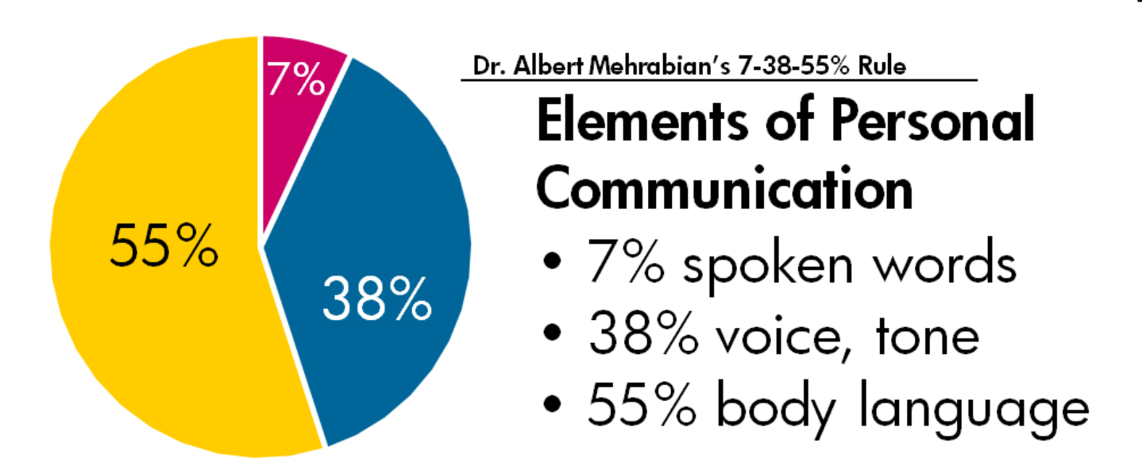
Therapeutic language
Therapeutic language is not limited to spoken language and may also involve nonverbal communication, such as body language and tone of voice. (4)
(
4) https://www.ncbi.nlm.nih.gov/pmc/articles/PMC2898840/

Slide 8
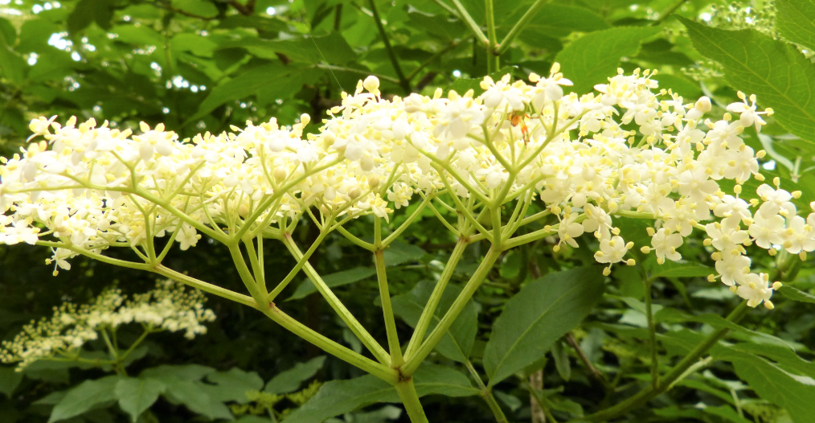
Using therapeutic language on a foraging walk
To help create a calming and supportive atmosphere that promotes well-being and relaxation
Encourage mindfulness: Encourage the person to focus on their senses and the present moment. Ask them to describe what they see, feel, smell, hear, touch, and taste.
Use descriptive language:
Encourage to describe the different textures, colors, and shapes
of the objects they find.
Create a positive atmosphere:
Use positive and encouraging language to create a relaxed and supportive atmosphere. Compliment the person on their observations and discoveries.

Slide 9
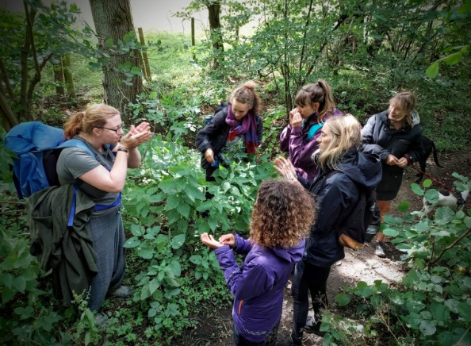
Using therapeutic language on a foraging walk
Encourage reflection: Encourage everyone to reflect on their experiences and feelings.
Ask them questions about their thoughts and emotions and listen attentively to their responses.
Connect with nature: Highlight the therapeutic benefits of being in nature and encourage
to connect with the surroundings. Talk about the natural beauty and the positive effects it can
have on one's mental health.
’Remember, everything works
better when you align with nature,
so optimise your sunlight, oxygen,
hydration, movement, connection
to the earth, relationships and
food intake.
The basics matter!’
https://totallywilduk.co.uk/
(6) Forage with Your Senses

Slide 10
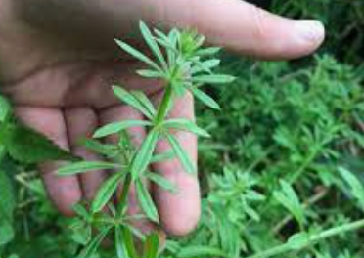
Foraging walks as opportunities for
developing more
self-knowledge
Questions that can help to connect to self
What happens inside of me at any given moment?
What does touch feel like?
What does breathing feel like?
What does stretching feel like?
We can be creative with plants
Nature doesn’t place demands
and expectations on us like people
often do.

Slide 11
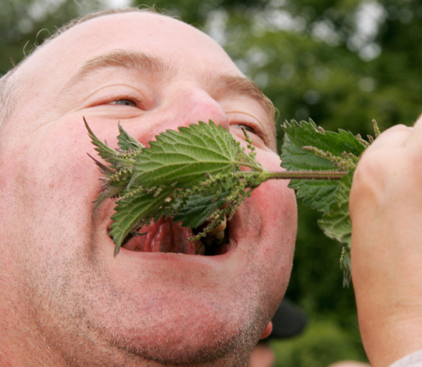
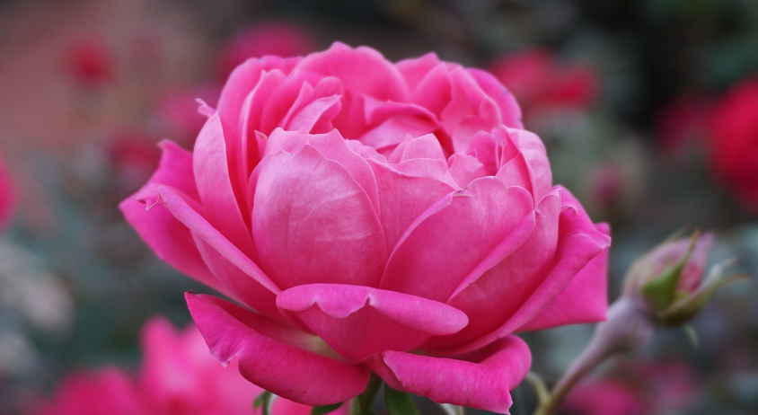
Nature allows us to be free to explore and discover
with less mental distractions
Engaging with our senses
Sound, smell, taste & after taste, colour ……
What is pleasant to some of us could be unpleasant
or triggering for others.
Awakening curiosity
What do I feel attracted to? (colour, smell, taste, touch, vibration, sound, light….)
What is it that attracts or repels me?
What scares me or gives me joy?
What happens in my body when I feel attraction & joy?
What happens in my body when I feel fear or dislike?
What would I like more of in my life?

Slide 12
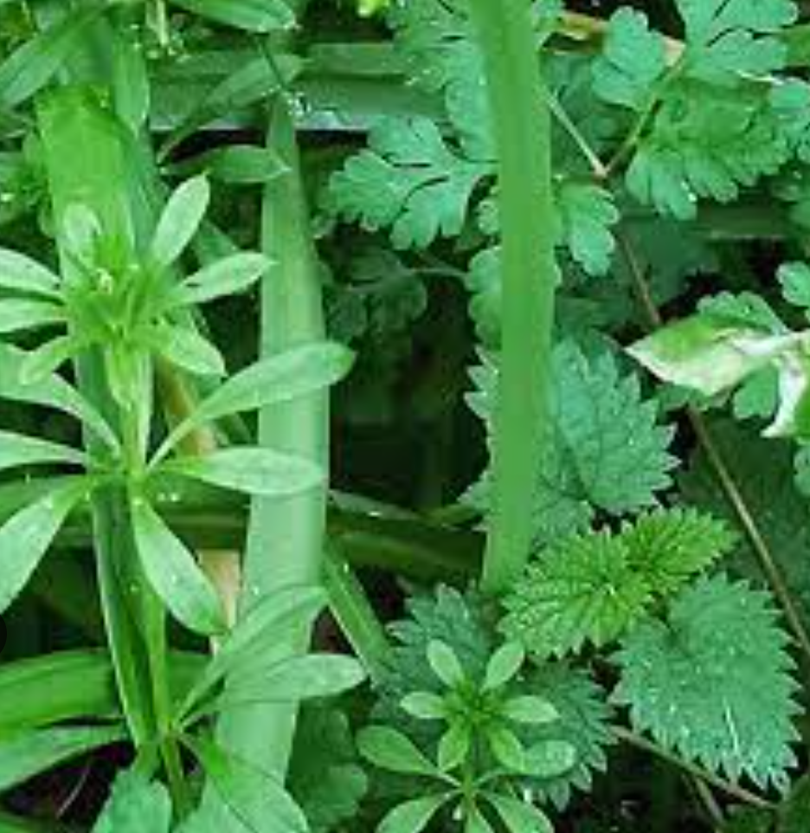
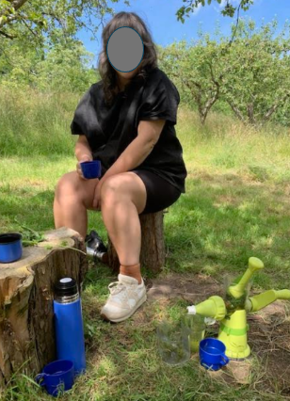
“ A wonderful chance to learn about nature and herbal remedies from a truly enthusiastic teacher! Everyone had something to share just by taking part and the pressure free wanderings through various environments really opened my eyes to life that has always been there but I’d never really noticed before. I truly see the world a different way since learning to forage a little, a very valuable experience. “
“The foraging walks with Anna were a chance to slow down
and tune in with nature. I was grateful to learn so much
about natural remedies and also to spend time reflecting
on different approaches to medicine and health."

Slide 13
“ I am having a lot more adventures with plants nowadays. When I go for a walk I find myself always looking at all the plants and noticing some that we foraged. I even brought back a whole big bunch of dandelion leaves from my holiday in Italy. I use the recipes we were given and would love to have some more.”
“The foraging walks played a big part in my transformation. I learnt how to use things to help my emotional and physical wellbeing. They also got me to go out in nature more often.”
“ “I also enjoyed all our discussions when we sat and enjoyed the lovely smoothies, pestos and teas you had prepared (a very nice surprise)! I think that last session reframed my mind on illnesses and I feel a lot more agency over my body which is a nice feeling. I will continue my foraging journey .”
“Foraging helped me to recognise my humble self – in nature.”
“Getting out into the countryside, feeling more part of nature and feeling reconnected to previous interests in herbs. Now making herbs part of the diet. I had given up on things I used to like ie using herbs, walking in nature. The programme made me realise it was the right time to bring herbs and animals and a healthy diet into my life. I have had no mouth ulcers during this time.”

Slide 14
“Foraging was a new experience. Would never have thought of it before.
Connection to Nature and to Animals and how important these connections are and have always been.
Used ‘to get lost in her life’. Now feels more appreciative of nature.”
“I rediscovered my creativity that fits my busy lifestyle and my physical health limitations.
I also go out more thanks to the foraging workshops and now know what and where to forage. It was also nice be in a group.”
“Foraging was lovely and helped me think more about what I put into my body.”
“Foraging in nature, feeling free in nature and how my anxiety disappeared. It felt quite cathartic. The group picnic in nature. I wouldn’t normally have made the effort to go out as trauma isolate.
Being part of a group made me go foraging. It was all for the greater good of healing through connection.”

Slide 15
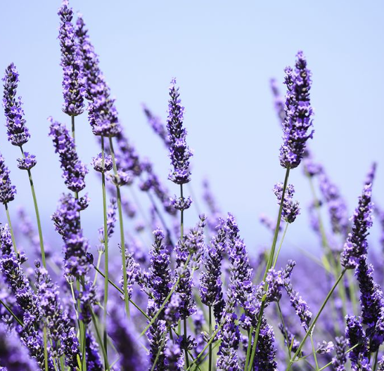
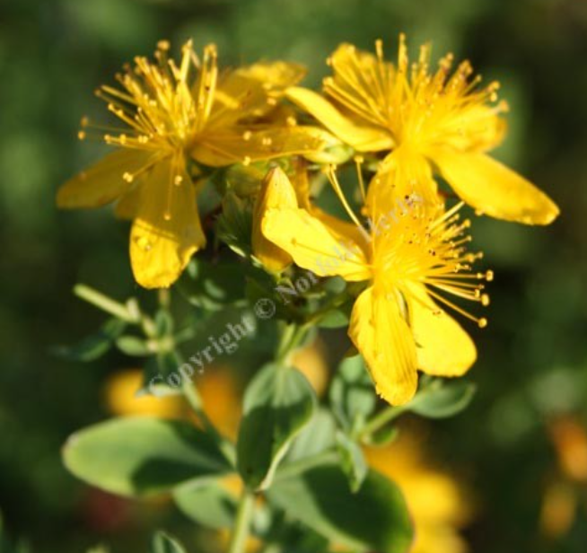
Learning how plants respond to their environment
and interact with it
Fragrances or aromas
Can affect our mood and behaviour
Plants effect on air quality
& the levels of pollutants in the atmosphere
Calming effect
Interacting with plants can help reduce stress
and improve mental health

Slide 16
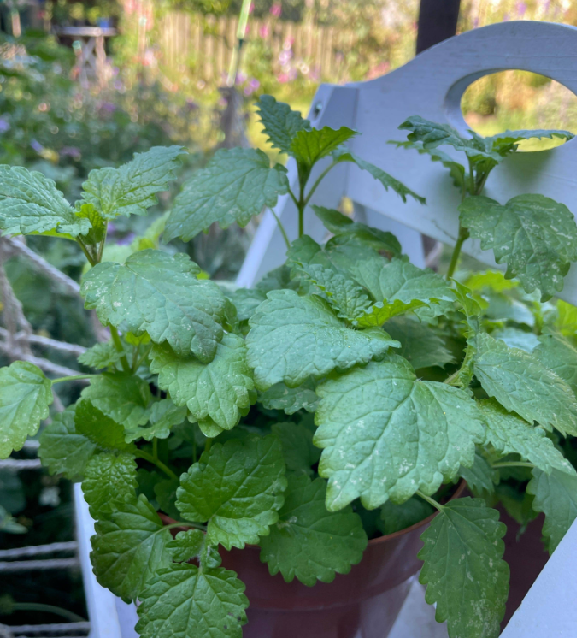
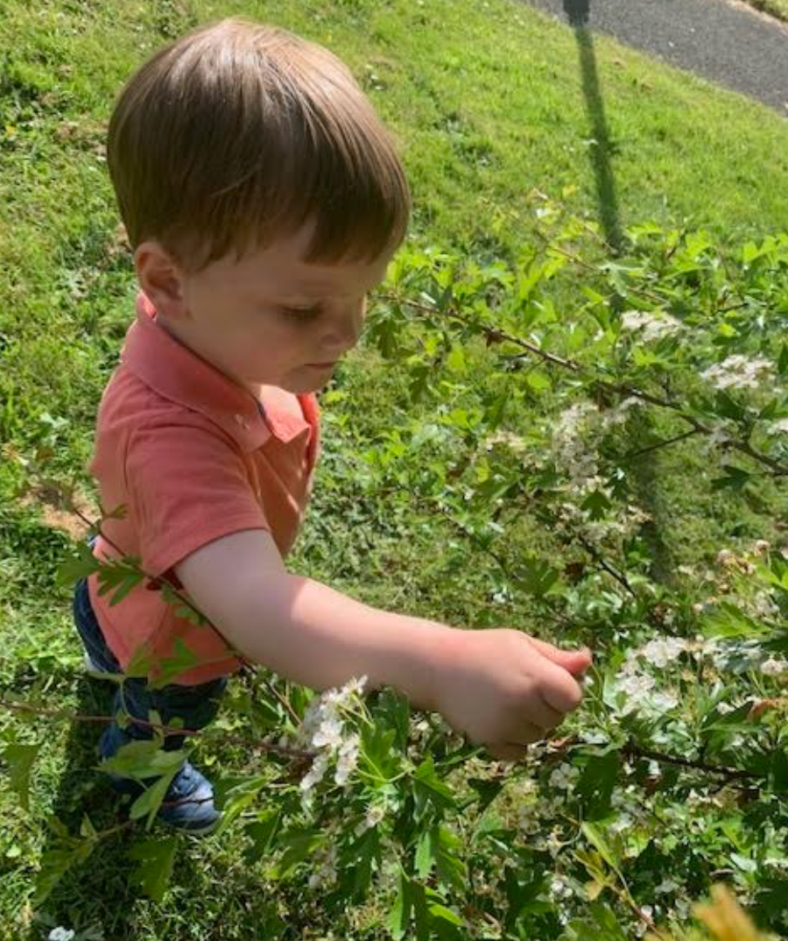
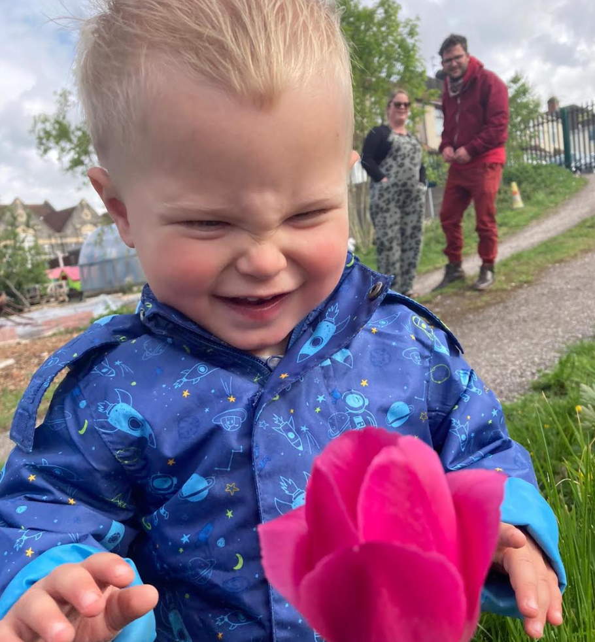
“ Walking into my kitchen in the morning, seeing, smelling and touching the Lemon Balm plant opens something up in me, makes me feel calm and grateful. It also gives me something to take care of.”
Nature provides many lifelong benefits across physical health, emotional health and mental health.
Nature experiences can help children understand the interconnectedness of our beautiful earth.

Slide 17
Our opportunity: Compassion
“Only when compassion is present will people allow themselves to
see the truth.” Gabor Maté (1) Passion = suffering; com = with
5 levels of Compassion - Dr Gabor Maté (2)
Empathy is not enough, understanding what happened is important
Whenever there is tension, it requires attention
Truth is important, powerful and liberating
Do what matters and don’t be attached to the outcome
Seeing everyone for the full human being and the potential they really are
https://drgabormate.com/
https://youtu.be/uzrqbrWLBaM

Slide 18
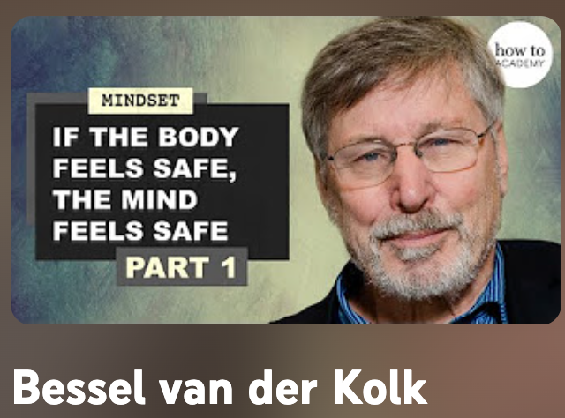
Healing Trauma &
How the Body Keeps the Score
“Getting to know this being that is me, to get to know what different things mean, to actually have a relationship to that creature who I am and to be very aware of what feeling uptight feels like and how I change it.”
Playlist – 3 videos
Notes:
Example he described
A woman with depression, he asked: what would you do more of if you were not depressed?
She replied going to Salsa dancing more often.
So he set her the task: go dancing next week and she reported feeling better at her next session

Slide 19
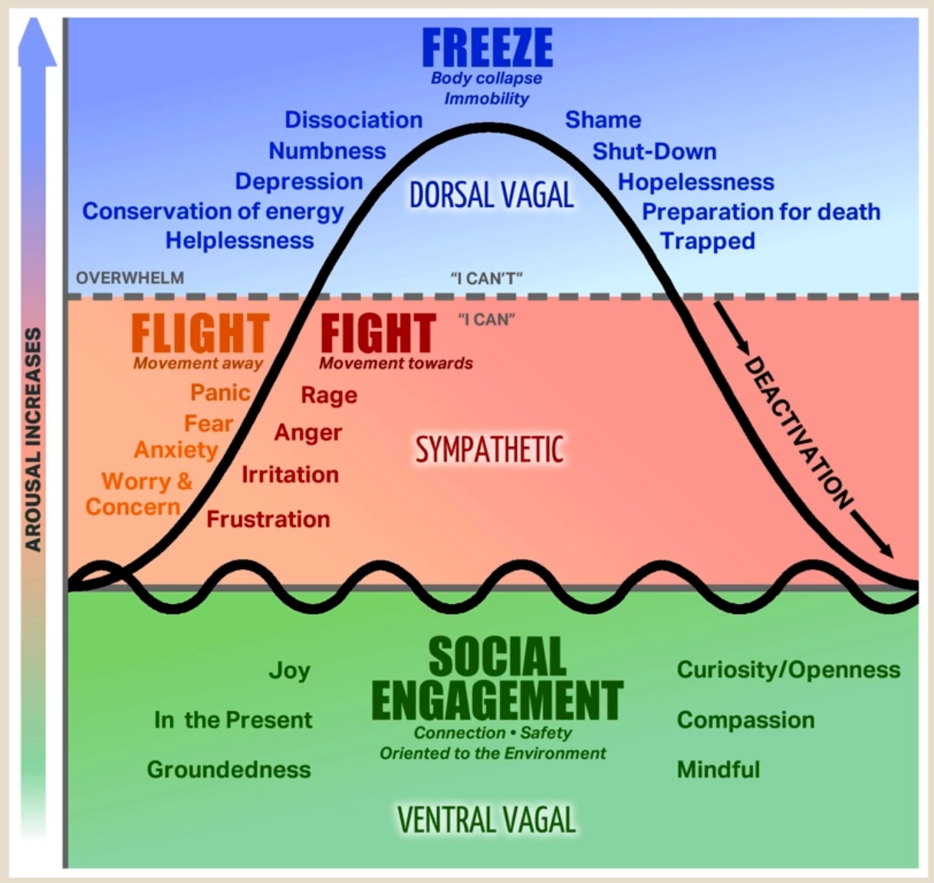
Polyvagal Theory
Dr.Stephen Porges is a professor of psychiatry at the university of North Carolina and the creator of the Polyvagal Theory.
The Polyvagal Theory serves to identify the relationship between visceral experiences and the
vagus nerve’s control of the heart, lungs and the digestive tract.

Slide 20
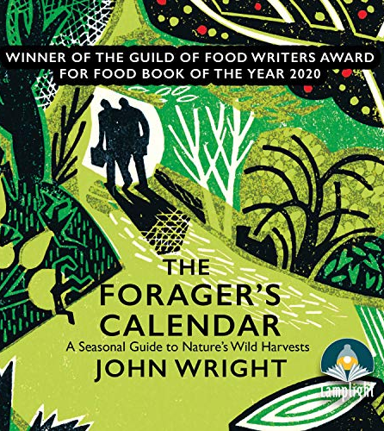
Other Resources
Tiny Habits
Book and podcast with Rangan Chatterjee
The Secret To Creating Habits That Stick: Professor BJ Fogg | Feel Better Live More Podcast
Audiobook: Listen free for 30 days
The Forager's Calendar
By: John Wright
Narrated by: John Wright
Length: 9 hrs and 55 mins
When the body says No & YouTube videos
with Dr Gabor Maté
‘When the Body Says No’ promotes learning and healing, providing transformative insights into how disease can be the body’s way of saying no to what the mind cannot or will not acknowledge.
5 Tips for Learning to Forage:
Key takeaways
Start with one
Make it an easy habit
Keep a record
Use all your senses
Share the experience

Slide 21
