Slide 1
What is Burnout? Prevention & Treatment
Based on a whole systems approach: Endobiogeny
“Inherent in the organism there exists an assembly of perpetually dynamic physiologic mechanisms intended to maintain the best
possible state of equilibrium of terrain for the
terrain in question.
In sickness or in health, the human being reacts
as a systemic unity.” Christian Duraffourd

Slide 2
UBUNTU - I am because you are
The false assumptions of separateness of one body function from another,
of one life from another, of scarcity and competition play a significant
role in creating modern diseases and maintaining the status quo:
i.e growing social isolation, fear of failure, feeling not good enough, anxiety
unhealthy lifestyles, lack of purpose & meaning in life …
Feeling valued and enjoying meaningful connections on the other hand
provide purpose, create happiness and contentment, inspire creativity
and innovation and bring out the best in people.
The next step in the evolution of healthcare needs empowered citizens
with an expanded sense of what else we can achieve together when we enable diverse approaches to engage actively with difficult challenges.

Slide 4
Continuous feedback loops
Every thought creates hormones/neurotransmitters and
every body sensation evokes feelings /thoughts ….
Emotional or psychological stress (or negative thoughts) can worsen physical symptoms.
Fear can lead to increases in certain chemicals that prepare us through the "fight or flight" response.
Thoughts start chain reactions that allow us to contract our muscles.
Whenever you have a thought, there is a corresponding chemical reaction
in your mind and body as a result. It is linked to physical sensations and
vice versa.

Slide 5
Signs and symptoms preceding or manifesting regarding burnout
Feeling tired or drained most of the time
Not feeling refreshed after rest
Feeling helpless, trapped and/or defeated
Feeling detached/alone in the world
Having a cynical/negative outlook
Self-doubt
Feelings of emptiness
Procrastinating and taking longer to get things done
Feeling overwhelmed
Imbalances in digestion and elimination
Sleep disturbances
Anxiety
Depression
Insomnia/ poor sleep
Lowered immune system
Trouble concentrating and poor focus

Slide 6
Factors that can lead to burnout?
Stress by not acknowledging or overriding one’s feelings of overwhelm
Anxiety, worry, fear
Over stimulation (excess use of electronic devices, bright lights, prolonged loud noise)
Lack of a daily routine (meal times, sleep time, work patterns)
Going to bed late at night
Lack of sleep
Caffeine and other stimulants
Eating ultra-processed foods, refined sugars, alcohol
Too many activities and multi-tasking
Long working hours in a highly pressured environment
Unresolved trauma
It's important to note that burnout can affect anyone, not just those experiencing high-stress

Slide 7
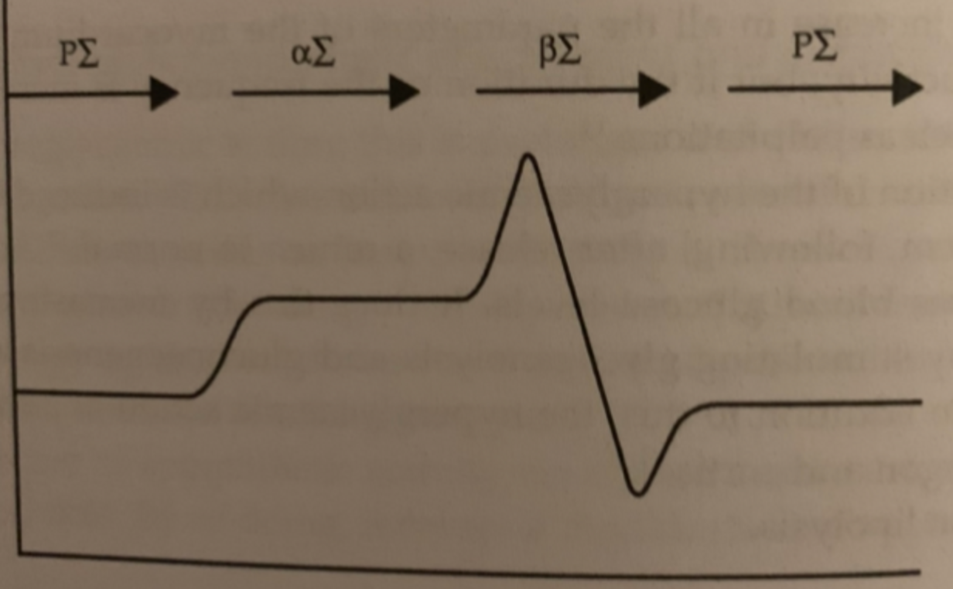
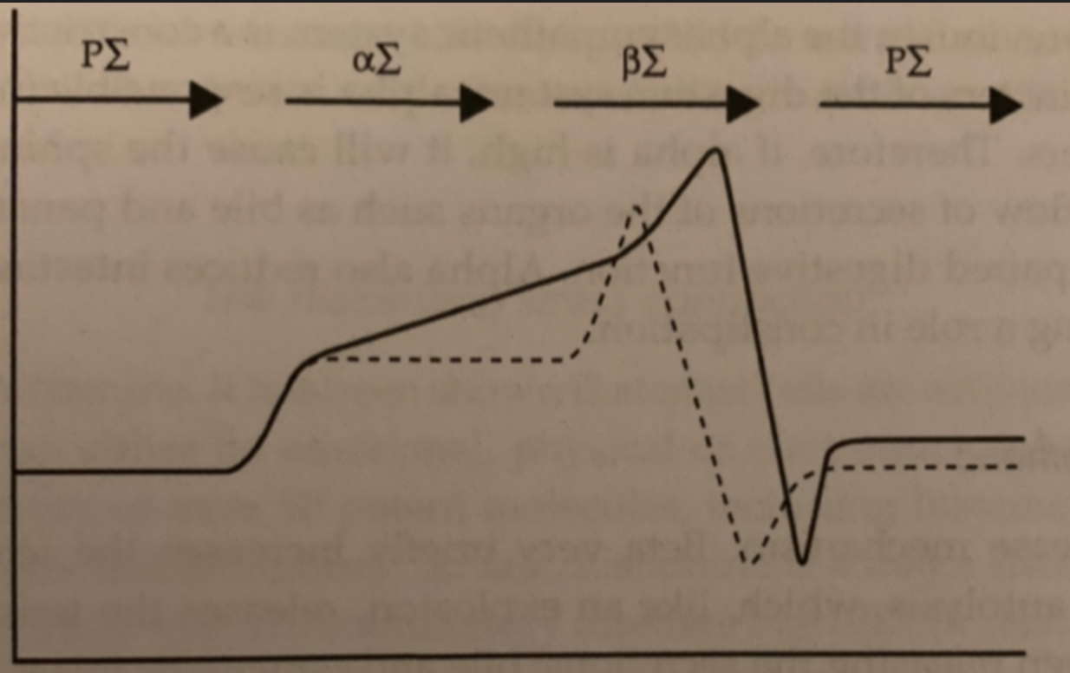
Stressors/aggressors causing alterations at the level of the Autonomic
Nervous System and the closely linked Endocrine System
Normal cycle of the ANS
Dysfunction in the cycle of the ANS
Para: sets the basal (resting) tone, regulates glandular secretions.
Raised para typically in introverts although not all introverts are high para
Alpha: follows para and regulates its action, constrictive in nature,
Raised alpha typically in very sensitive and reactive people, always on alert
Beta: briefly increases tension and releases it to allow secretions to flow
Raised beta typically in overly expressive & forceful individuals, aggressive behaviour, disinhibition
Blocked beta/blocked adrenaline: allergic type conditions with extended alpha/spasmophilia

Slide 8
Burnout occurs when you are not able to properly adapt to a stressor because your body lacks necessary reserves
The specific dysadaptation determines how burnout affects your body
i.e. feeling more anxious, withdrawn, tired or easily upset & angered
Lack of serotonin, high or low thyroid function or excess cortisol may
be involved in the downstream mechanism.
The lived experience of burnout/exhaustion by the individual needs to
be taken into account in any treatment ie a combination of psychological
treatment & lifestyle adjustments alongside (herbal) pharmacological
treatment to address the imbalance of hormones.

Slide 9
Lifestyle & work
Regulate sympathetic output
Meditative exercises (Qi gong, yoga, T’ai Chi…)
Healthy mutually supportive relationships Spend time with the people whose company you enjoy, where you can feel relaxed, understood and authentic.
Practise breathing: Bring attention to your breath & extend outbreath
Spend time in nature: Mother Nature truly helps to ground the body and mind. Taking time regularly to walk in the park, sit by some water or sit by a local tree.
Engage in creative activities - Spend time with the people you love and make time to do the things you enjoy e.g. cooking, painting, photography long walks, observing nature Prioritizing fulfilment can help counteract working in a depleting job.
Set boundaries & practise Agency : Learn to say ’No’. Take responsibility for your actions.
Oil massage: Oils counteract the dryness created by stress. Use warm sesame seed oil to perform a self-oil massage. Can be a full body massage or just oiling the crown, forehead and soles of the feet before bed.
Unplug : Learn the difference between relaxation & distraction.
Find a practice that appeals to you such a journaling, meditation, mantra chanting,
breathing exercises or yoga. These will all help to balance hormones, reduce stress and rebuild energy. Spending a lot of time on social media increases nervous system activity.

Slide 10
SLEEP

Slide 11
Diet & Natural supplements
Eat foods as close to their natural state as possible & as fresh
as possible incl foraged foods ie dandelions, rosehips …
Diet high in lean animal products: pasture-raised, antibiotic- and
hormone-free meat, free range eggs
Healthy fats: Sprouted seeds, nuts & seeds, olive oil, oily fish …..
Eat plenty of fresh vegetables espec. green leafy veggies
Fresh fruits espec red berries - high in antioxidants
Foods rich in calcium and vitamin C (1tbsp of chia seeds = 10g, provides
52g of calcium and 4g of fibre. Chia seeds are a source of healthy fats and high in omega-3)
B vitamins to support nervous system (i.e Avocados, Bananas, Brewers yeast)
Magnesium glycinate - calms nervous system & helps sleep
5 HTP if serotonin is low & for poor sleep.
Also Saffron can facilitate dopamine, serotonin, and noradrenaline. I can help sleep & mood.
Saffron also has anti-oxidant and anti-inflammatory properties.

Slide 12
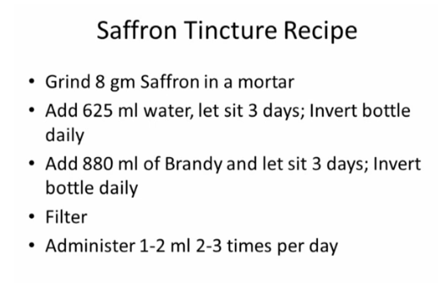
Saffron

Slide 13
Herbal Treatment
Focus on improving nervous system balance
Stress reduction
Reduce overstimulation
Lime flowers
Lavender
Chamomile
Passion flower
Valerian
Lemon Balm
Hawthorn
Skullcap (enhances production of endorphins, eases depression, dispels tiredness and nervous exhaustion, and promotes sleep.)
Regulation of stress response:
Use adaptogens to reduce excessive cortisol and improve adrenal cortex function:
Roseroot (Rhodiola rosea): best general adaptogen, effective compared to sertraline (Mao et al., 2015)
Siberian ginseng (Eleutherococcus senticosus): best with insomnia due to an excessively busy mind
Ashwagandha (Withania somnifera): useful when anxiety is significant, feeling run down from chronic stress & overwork
Bacopa: calms mental turbulence and aids meditation.
Gotu Kola: improves brain and other mental functions, especially when suffering from stress.
https://www.herbalreality.com/western-action/adaptogens/

Slide 14
Herbal Treatment
Focus on improving nervous system balance
General adrenal cortex support
will inhibit excessive ACTH stimulation of cortisol
GEMMO THERAPY (GM) – special tinctures made from plant buds
Ribes nigrum GM (Black currant): best general single support
Rosa canina GM (Dog Rose): depression with prominent digestive problems related to SI inflammation; loss of libido
Sequoia gigantia GM (Sequoia tree): if Cortisol/Adrenal cortex ˃ 5: shifts adrenal metabolism from cortisol to adrenal androgens; indicated in peri-gonadopausal depression
Quercus pedunculata GM (Oak): multi-endocrine dysfunction in depressed patients; state of mental or emotional shock
Siberian Ginseng (Eleutherococcus senticosus): depression with prominent deep fatigue and insomnia

Slide 15
Herbal Treatment
Addressing possible insufficiencies in order to end diversion of adrenals from cortisol
Possible herbs include:
Korean (Panax) ginseng: adaptogen, gonadotropic
Maca - Lepidium meyenii : adaptogen, gonadotropic
Ginger: corticotropic, androgenic, thyroid stimulant
Siberian Ginseng – Eleutherococcus: adaptogen, corticotropic, androgenic
Sage: corticotropic, oestrogenic, hepatic

Slide 16
Using the power of nature to amplify
the healing force in all of us​​
Remember: We are all part of nature !
We are inherently relational beings and become who we are through associating with others.
The word “ubuntu” means that a person is a person through the recognition
of the other, so there is a demand for re-cognising the humanity bestowed
upon the other. In fact we create each other.
We are because you are, because you and I are interdependent.

Slide 18
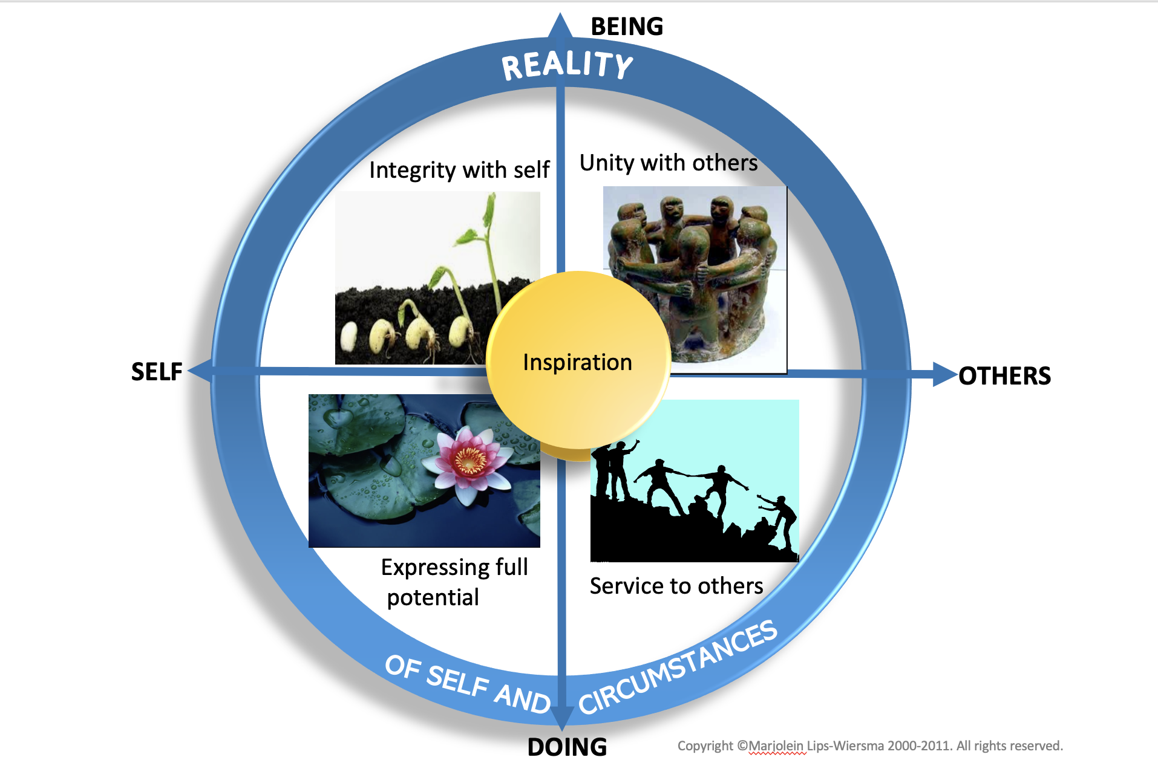
Map of Meaning
for both individual & collective meaning making
Shifting from feeling a victim to experiencing agency
Experiencing meaning & purpose in life and work, expressing who we truly are and what matters to us helps building reserves & resilience.

Slide 20
Thank you for your attention
Anna Betz www.unleashourhealth.com
Mob: 07731584358

